Slide 1
The impact of aviation on cirrus cloud formation in European airspace
ADS Research project

Slide 2
The Research Project
ADS Research project
- Part of the Applied Data Science profile, integrated in Climate Physics master
- Project should be interdisciplinary
- Till the end of this quarter (Friday 23rd April)
- Assessment through a final report (anything else?)

Slide 3
Project Motivation
ADS Research project
- Contribution of clouds to climate change is topic of ongoing research
- Cirrus clouds appear to play a significant role in Global Warming
- Impact of aviation sector to climate through indirect cloud effects is estimated larger than direct (CO2) effects
- For a long time cirrus clouds were hard to detect from satellite observations (optically thin and often multi-layered)

Slide 4
Project Concept
ADS Research project
- Restrict the ROI to European airspace -> high data availability, in high temporal and spatial resolution, and high traffic density
- Possibility to look at changes in cirrus cloud cover due to air traffic, and/or cloud properties (particle size, optical depth)
- Detection of spatial and temporal trends (air traffic increases by 4% each year, is there any visible trend in cirrus cloud cover?)
- Algorithm to discern atmospheric cirrus formation from air traffic induced cirrus formation, and to account for advective processes?

Slide 5
Air traffic data from EUROCONTROL
ADS Research project
- Totality of 16 months of data from 2015 till 2018 (March, June, September and December)
- Data sets of tracked geolocated flights (in variable time intervals) including FL within European air space
- Additionally data sets containing DEP and ARR airports, scheduled and actual DEP and ARR times, aircraft type, carrier, flight type and market (e.g. Lowcost, Charter)
- Opens up possibilities for additional interesting research questions?

Slide 6
Air traffic data from EUROCONTROL
ADS Research project
- For analyzed days in March 2015 about 70,000 flights a day, and about 700,000 reported geolocations
- Made animation by interpolating geolocated data in consistent 15 min intervals

Slide 7

ADS Research project

Slide 8
Satellite data
ADS Research project
- From Polar orbiting satellites MODIS cloud products resulted most accessible (both level 2 and daily means level 3 data), but temporal resolution not satisfactory (probably the same for all polar orbiting satellites)!
- Geostationary satellites the way to go?

Slide 9
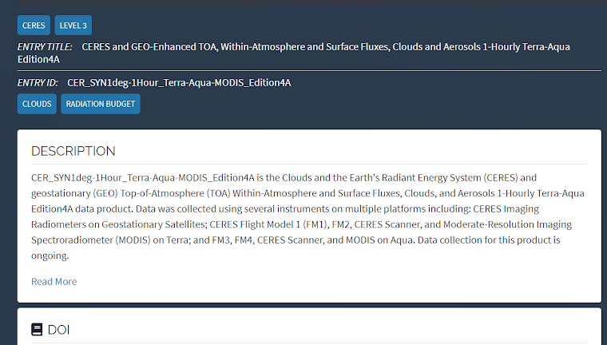
Satellite data
ADS Research project

Slide 10
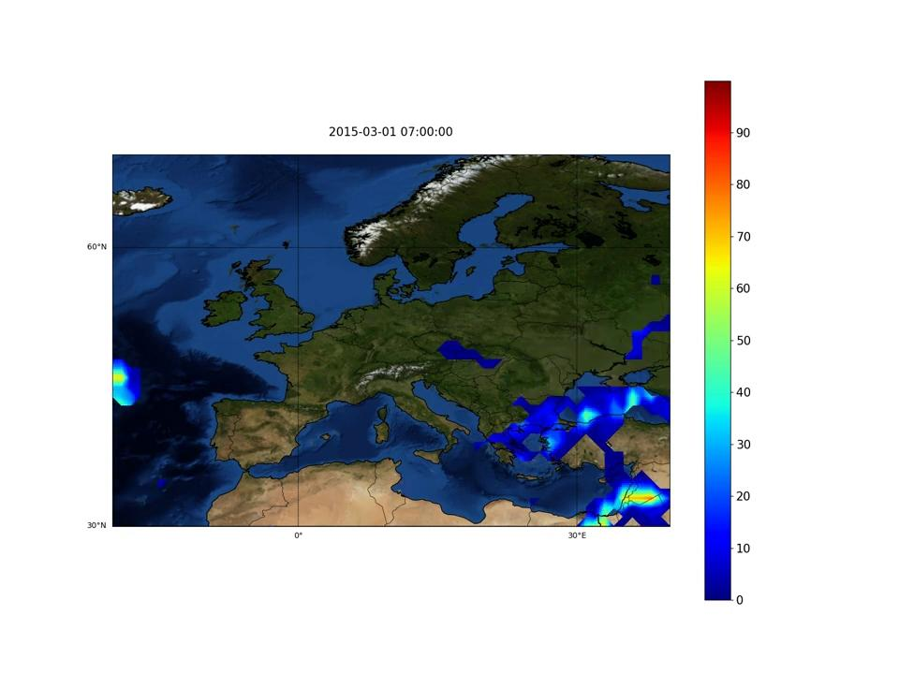
CERES/GEO product: upper cloud layer coverage (%)
ADS Research project

Slide 11
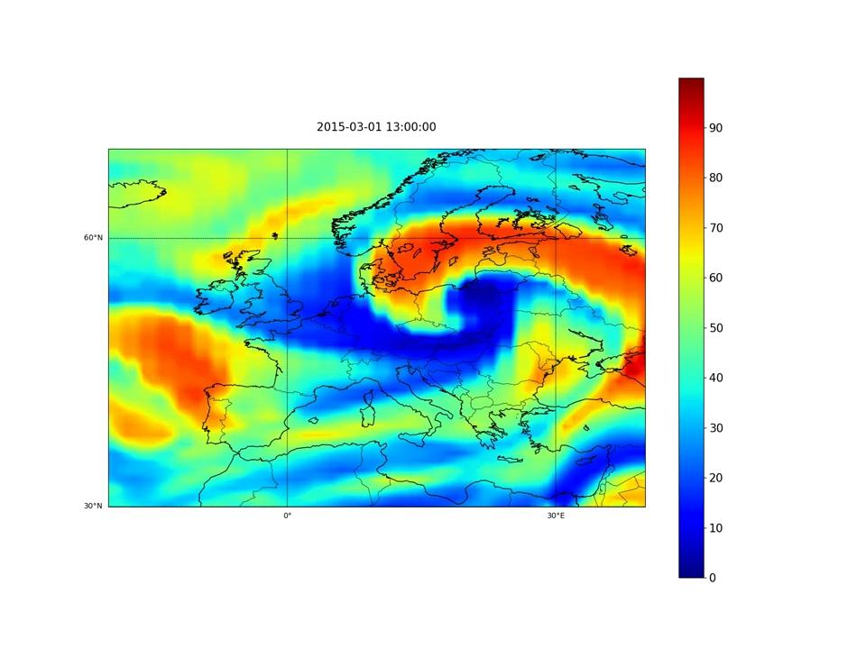
CERES/GEO product: upper tropospheric relative humidity
ADS Research project

Slide 12
What is next?
ADS Research project
- Further explore satellite data product (are there any alternatives)?
- Identification of all research questions
- Exploratory Data Analysis

